Slide 1
Multiple View Geometry
Last updated: 23-05-2024
Szeliski R., Computer Vision - Algorithms and Applications, Springer, 201, Ch. 12.
Solem, J. E., 2012. Programming Computer Vision with Python: Tools and algorithms for analyzing images. "O'Reilly Media, Inc.“, Ch. 5.
Dr. M. Aksam Iftikhar,
Associate Professor
http://vig.cuilahore.edu.pk
Notes:
http://www.cs.cornell.edu/courses/cs6670/2009fa/lectures/lectures.html

Slide 2
Topics
Basic Camera modelling
Depth Estiimation
Stereo vision
Epipolar geometry

Slide 3
Image Formation
Let’s design a camera
Idea 1: put a piece of film in front of an object
Do we get a reasonable image?

Slide 4
Pinhole Camera
Add a barrier to block off most of the rays
This reduces blurring
The opening known as the aperture
How does this transform the image?
Notes:
It gets inverted

Slide 5
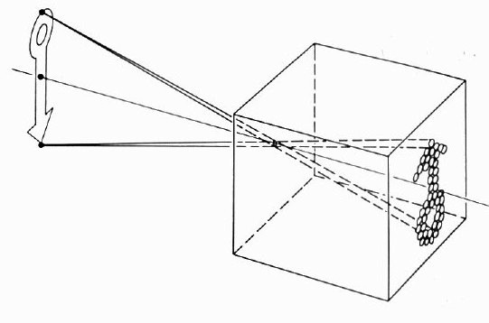
Pinhole Camera
Basic principle known to Mozi (470-390 BC), Aristotle (384-322 BC)
Drawing aid for artists: described by Leonardo da Vinci (1452-1519)

Slide 6
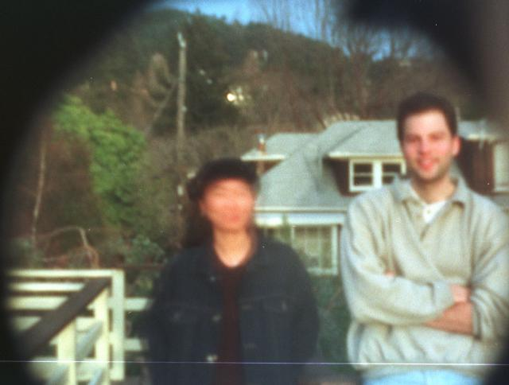
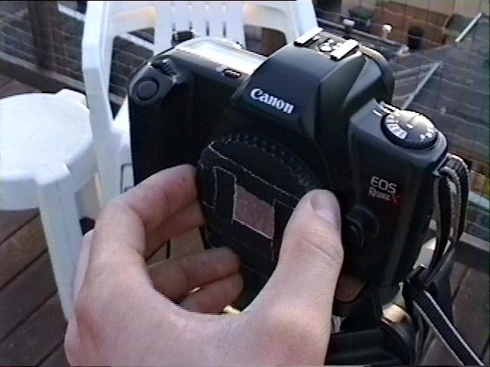
Pinhole Camera - Result
Home made pinhole camera
35mm Single-Lens Reflex Pinhole Photography
Why so blurry?
http://www.debevec.org/Pinhole/

Slide 7
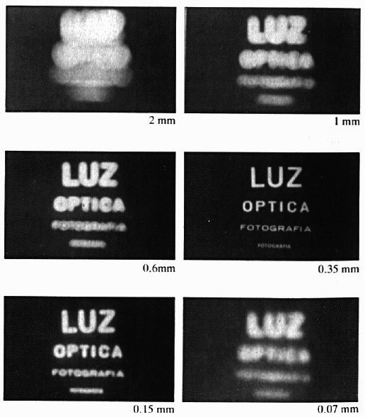
Shrinking the Aperture
Why not make the aperture as small as possible?
Less light gets through
Diffraction effects...
Diffraction is the phenomenon where light waves bend around obstacles and spread out as they pass through small openings. When the aperture of a pinhole camera is very small, diffraction becomes significant and affects the image quality.

Slide 8
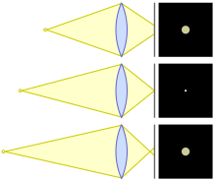
Adding a Lens
Lenses can be used
to gather light
to focus light
A lens focuses light onto the film
There is a specific distance (called the focal length) at which objects are “in focus”
other points project to a “circle of confusion” in the image
Changing the shape of the lens changes this distance
Circle of confusion
Diagram showing circles of confusion for point source too close, in focus, and too far
Notes:
In optics, a circle of confusion is an optical spot caused by a cone of light rays from a lens not coming to a perfect focus when imaging a point source. It is also known as disk of confusion, circle of indistinctness, blur circle, or blur spot.

Slide 9
Depth Estimation and Stereo Reconstruction

Slide 10
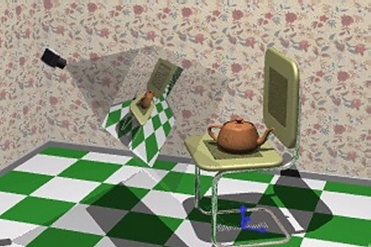
Introduction…
Humans have the natural ability to perceive 3D world.
When conventional cameras capture the pictures, the depth information is lost due to the projection of a scene onto the 2D image plane.

Slide 11
Recovering 3D from Images
How can we automatically compute 3D geometry from images?
What cues in the image provide 3D information?
Notes:
http://vision.stanford.edu/teaching/cs131_fall1516/lectures/

Slide 12
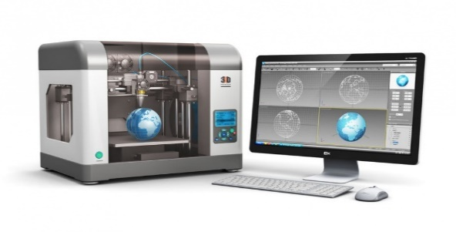
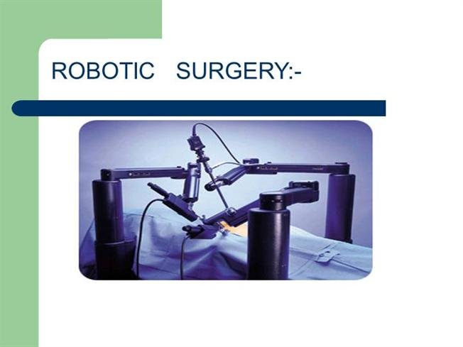

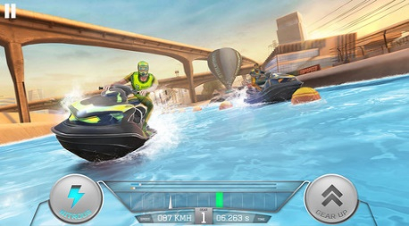
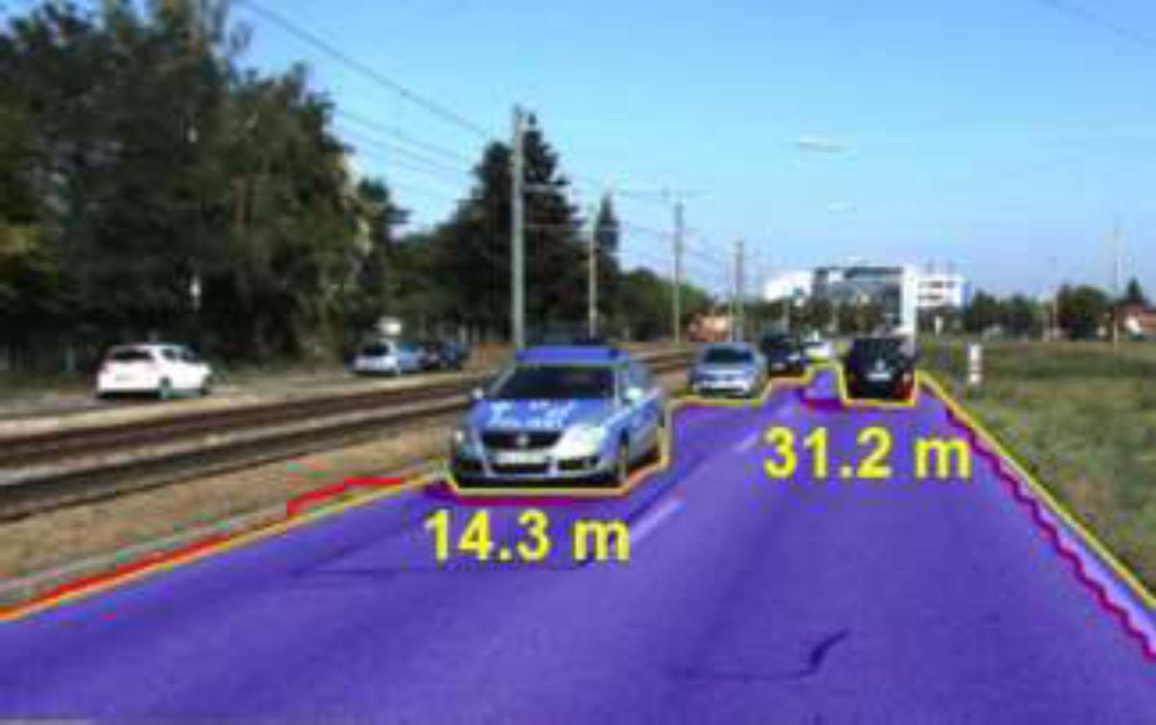
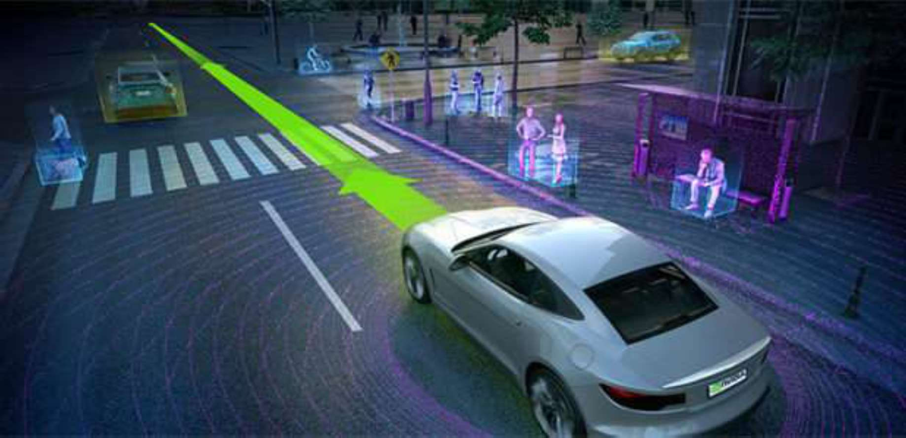
Introduction
Recovering the 3D structure of a scene from a single image (called monocular image) has become an important research problem in the present years due to its wide range of applications.
3D Printing
Robotic surgery
3D games/ movies
Self Driving cars / Robot navigation

Slide 13
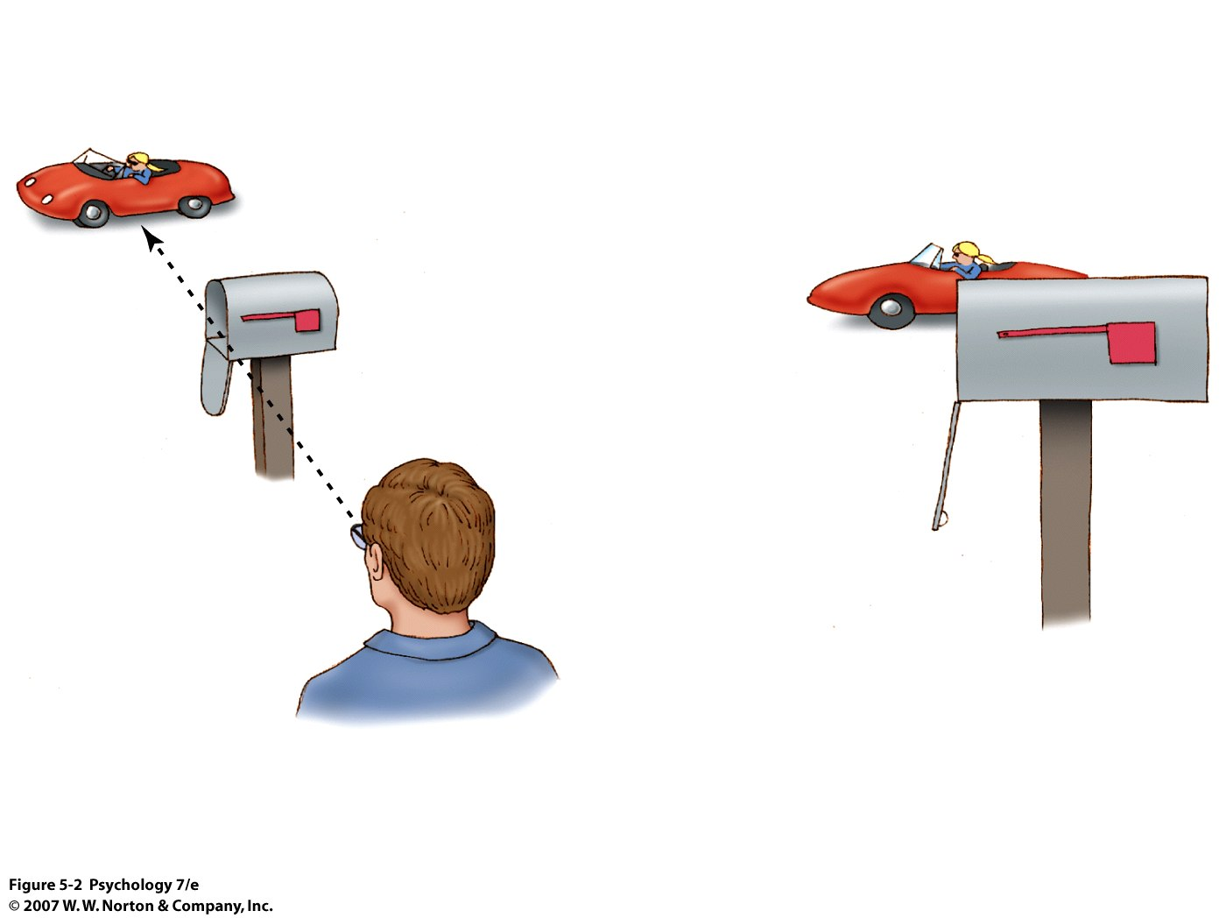
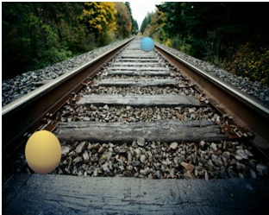

Depth Estimation
Depth estimation involves determining the distance from the camera to various points in the scene.
This can be done using multiple images (stereo vision) or from a single image using various monocular cues.
Notes:
http://www.bim.bilkent.edu.tr/~inanc/psy/lecturenotes/ch5.ppt

Slide 14
Introduction
Monocular Depth Cues…
Interposition
When one object blocks another, the blocking object is perceived to be closer.
Linear perspective
Parallel lines appear to converge as they recede into the distance.
Texture Gradients
The texture of objects tend to become smoother as the object gets farther away, suggesting that more detailed textured objects are closer.
Notes:
http://www.bim.bilkent.edu.tr/~inanc/psy/lecturenotes/ch5.ppt

Slide 15

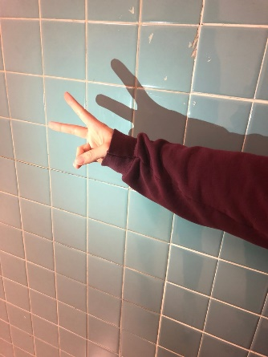
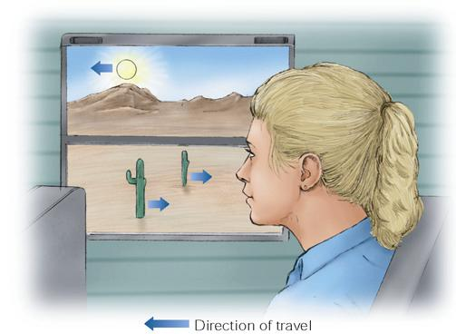
Introduction
Monocular Depth Cues
Relative Size
Larger objects are perceived as being closer to the viewer, and smaller objects as being farther away.
Light and Shadow
When objects are darker or shaded they are perceived as farther away.
Motion Parallax
When you ride in a moving vehicle and look at the side window, the objects seem to be moving with different speeds-the ones that are closer to you seem to move faster, whereas objects far behind seem to move slower
Notes:
http://www.bim.bilkent.edu.tr/~inanc/psy/lecturenotes/ch5.ppt

Slide 16
Stereo Reconstruction
Stereo reconstruction is the process of recovering the three-dimensional structure of a scene from two or more images taken from different viewpoints (called the Stereo problem).
– Biological motivation
Why do we have two eyes?

Slide 17
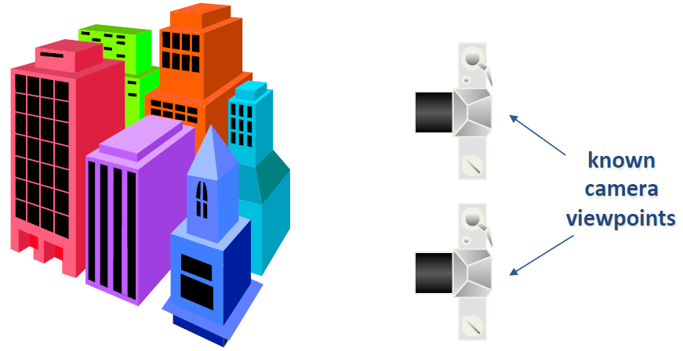
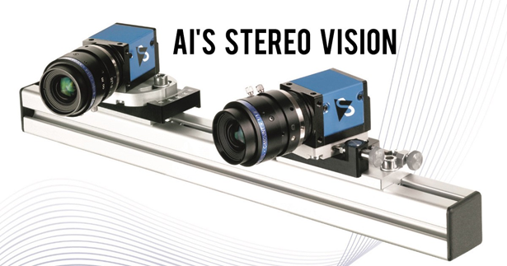
Stereo Camera setup
Two or more images of the same scene are captured from different viewpoints. Typically, these images are taken using a stereo camera setup where the cameras are positioned side by side with a known baseline distance between them.
The Stereo Problem
– Shape from two (or more) images

Slide 18
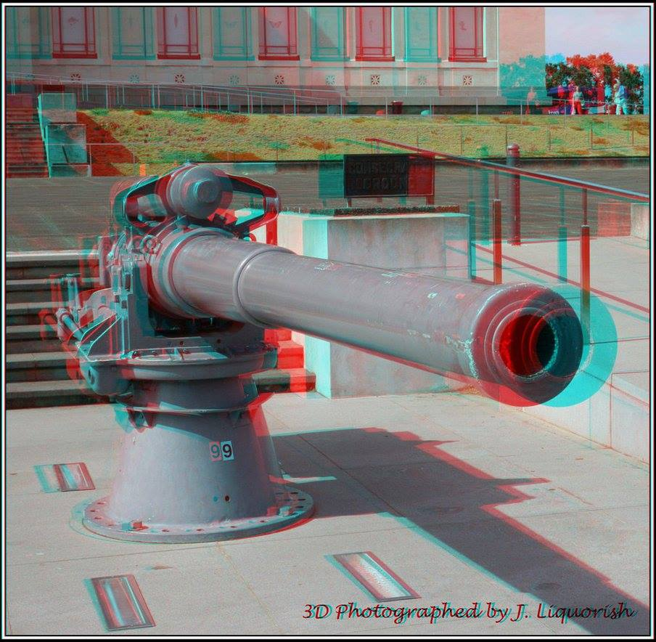
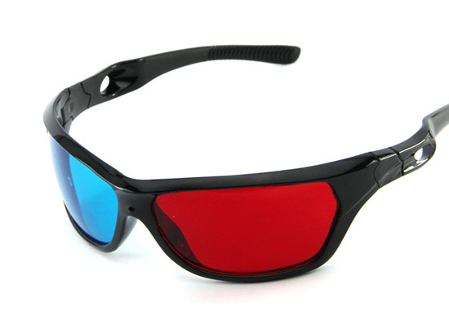
Stereograms Anaglyphs
Notes:
https://en.wikipedia.org/wiki/Anaglyph_3D
Anaglyph 3D is the stereoscopic 3D effect achieved by means of encoding each eye's image using filters of different (usually chromatically opposite) colors, typically red and cyan. Anaglyph 3D images contain two differently filtered colored images, one for each eye. When viewed through the "color-coded" "anaglyph glasses", each of the two images reaches the eye it's intended for, revealing an integrated stereoscopic image. The visual cortex of the brain fuses this into the perception of a three-dimensional scene or composition.

Slide 19
Epipolar Geometry

Slide 20
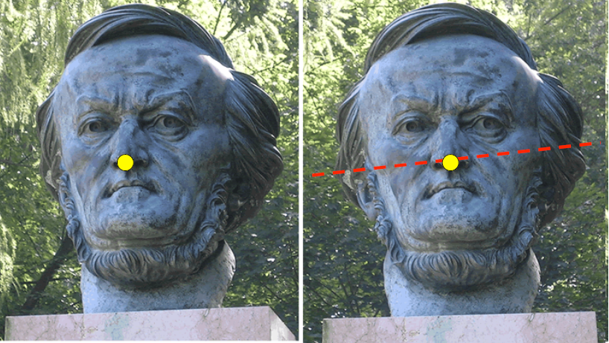
Epipolar Geometry
Epipolar geometry is the geometry of stereo vision. When two cameras view a 3D scene from two distinct positions, there are a number of geometric relations between the 3D points and their projections onto the 2D images that lead to constraints between the image points.
Two views of the same object
Suppose I know the camera positions
Given a point on left image, how can I find the corresponding point on right image?

Slide 21
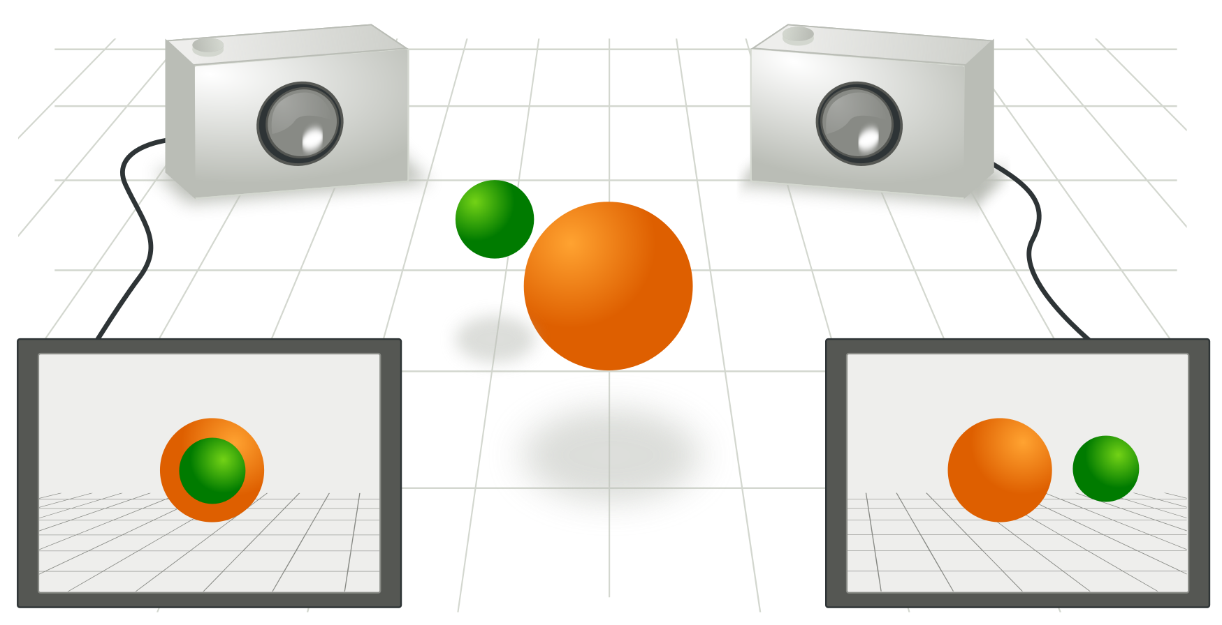
Epipolar Geometry
Two cameras take a picture of the same scene from different points of view.
The epipolar geometry then describes the relation between the two resulting views.

Slide 22
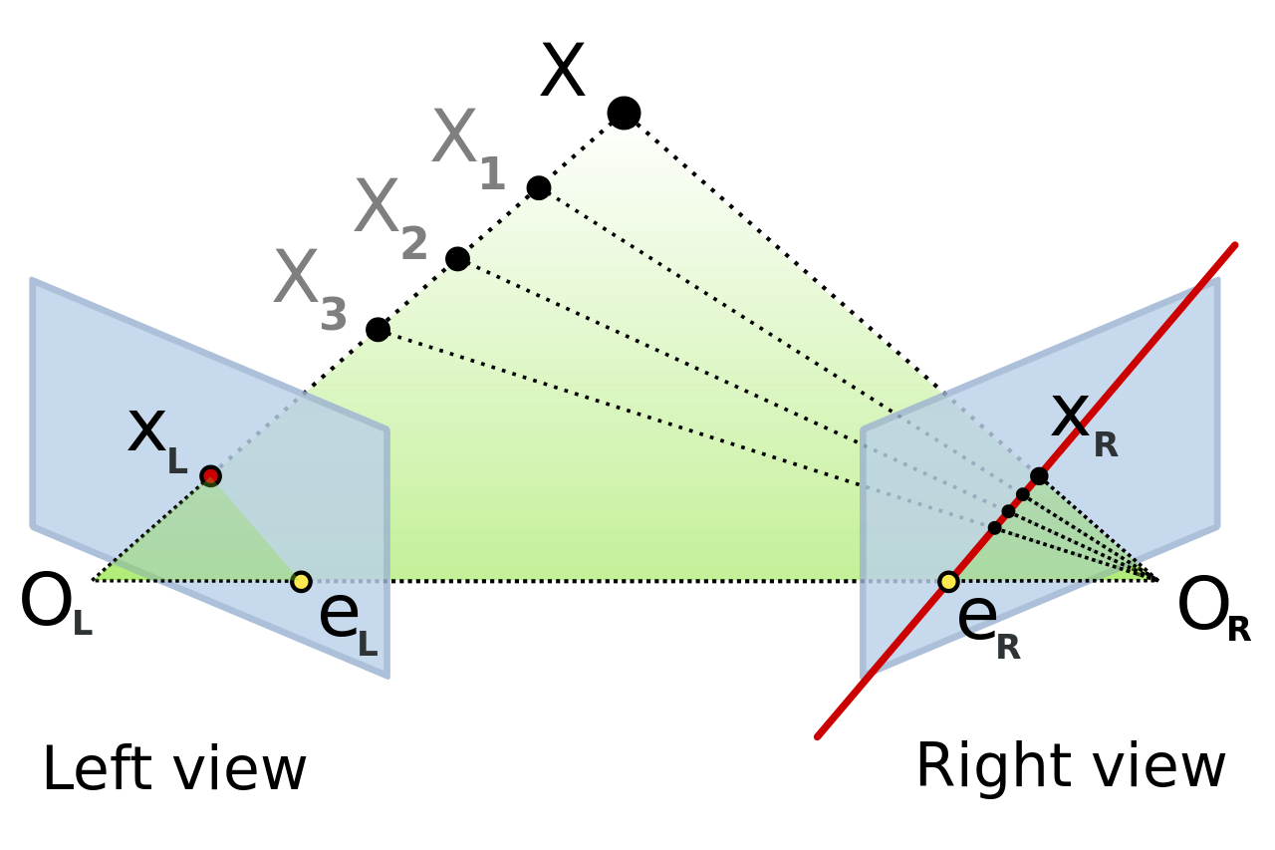
Epipolar Geometry
The figure depicts two pinhole cameras looking at point X.
Note that in real cameras, the image plane is actually behind the focal center, and produces an image that is symmetric about the focal center of the lens.
Here, however, the problem is simplified by placing a virtual image plane in front of the focal center i.e. optical center of each camera lens to produce an image not transformed by the symmetry.
O_{L} and O_{R}: the centers of symmetry of the two cameras lenses.
X: the point of interest in both cameras.
x_{L} and x_{R}: are the projections of point X onto the image planes.
Notes:
https://en.wikipedia.org/wiki/Epipolar_geometry#Epipolar_constraint_and_triangulation

Slide 23
Epipolar Geometry
Each camera captures a 2D image of the 3D world.
This conversion from 3D to 2D is referred to as a perspective projection and is described by the pinhole camera model.
It is common to model this projection operation by rays that emanate from the camera, passing through its focal center. Each emanating ray corresponds to a single point in the image.
O_{L} and O_{R}: the centers of symmetry of the two cameras lenses.
X: the point of interest in both cameras.
x_{L} and x_{R}: are the projections of point X onto the image planes.

Slide 24
Epipolar Geometry
Epipole or Epipolar Point
Each camera’s optical center projects onto a distinct point into the other camera's image plane.
These two image points, denoted by e_{L} and e_{R}, are called epipoles or epipolar points.
Both epipoles e_{L} and e_{R} in their respective image planes and both optical centers O_{L} and O_{R} lie on a single line.
O_{L} and O_{R}: the centers of symmetry of the two cameras lenses.
X: the point of interest in both cameras.
x_{L} and x_{R}: are the projections of point X onto the image planes.

Slide 25
Epipolar Geometry
Epipolar Line
The line O_{L}–X is seen by the left camera as a point because it is directly in line with that camera's lens optical center.
However, the right camera sees this line as a line in its image plane. That line (e_{R}–x_{R}) in the right camera is called an epipolar line.
Symmetrically, the line O_{R}–X seen by the right camera as a point is seen as epipolar line e_{L}–x_{L}by the left camera.
O_{L} and O_{R}: the centers of symmetry of the two cameras lenses.
X: the point of interest in both cameras.
x_{L} and x_{R}: are the projections of point X onto the image planes.

Slide 26
Epipolar Geometry
An epipolar line is a function of the position of point X in the 3D space, i.e. as X varies, a set of epipolar lines is generated in both images.
Since the line O_{L}–X passes through the optical center of the lens O_{L}, the corresponding epipolar line in the right image must pass through the epipole e_{R} (and correspondingly for epipolar lines in the left image). All epipolar lines in one image contain the epipolar point of that image. In fact, any line which contains the epipolar point is an epipolar line since it can be derived from some 3D point X.
O_{L} and O_{R}: the centers of symmetry of the two cameras lenses.
X: the point of interest in both cameras.
x_{L} and x_{R}: are the projections of point X onto the image planes.

Slide 27
Epipolar Geometry
Epipolar Plane
As an alternative visualization, consider the points X, O_{L} & O_{R} that form a plane called the epipolar plane.
The epipolar plane intersects each camera's image plane where it forms lines—the epipolar lines.
All epipolar planes and epipolar lines intersect the epipoles regardless of where X is located.
O_{L} and O_{R}: the centers of symmetry of the two cameras lenses.
X: the point of interest in both cameras.
x_{L} and x_{R}: are the projections of point X onto the image planes.

Slide 28
Epipolar Geometry
Epipolar Constraint
If the relative position of the two cameras is known, this leads to an important observation:
For each point observed in one image the same point must be observed in the other image on a known epipolar line.
This provides an epipolar constraint:
The projection of X on the right camera plane x_{R} must be contained in the e_{R}–x_{R} epipolar line. All points X e.g. X₁, X₂, X₃ on the O_{L}–X_{L} line will verify that constraint.
O_{L} and O_{R}: the centers of symmetry of the two cameras lenses.
X: the point of interest in both cameras.
x_{L} and x_{R}: are the projections of point X onto the image planes.

Slide 29
Epipolar Geometry
In general,
• If 𝑝𝐴 is a point known in Camera A's image, the corresponding point 𝑝𝐵 in Camera B's image must lie on the epipolar line 𝑙𝐵 of camera B.
• Similarly, if 𝑝𝐵 is a known point in Camera B's image, the corresponding point 𝑝𝐴 in Camera A's image must lie on the epipolar line 𝑙𝐴 of camera A.
• This constraint reduces the 2D search problem to a 1D search problem along the epipolar line.

Slide 30
Applications of Epipolar Geometry
Stereo Vision: Facilitates depth estimation by simplifying the search for corresponding points between stereo images.
3D Reconstruction: Enables the creation of 3D models from multiple 2D images by providing geometric constraints.
Computer Graphics: Enhances realism in rendering 3D scenes by accurately projecting 3D points onto 2D images.
Virtual Reality (VR): Creates immersive experiences by accurately reconstructing 3D environments from stereo images.

